Slide 1
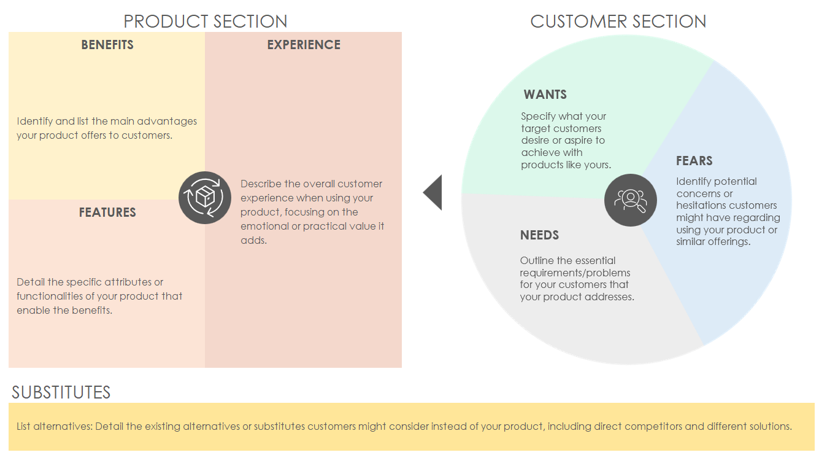
VALUE PROPOSITION BUSINESS MODEL CANVAS TEMPLATE
VALUE PROPOSITION BUSINESS MODEL CANVAS
On the next slide, begin by filling in the Product section with your deep understanding of the product. Then, shift focus to your target customers, using market research or customer feedback to articulate their Wants, Needs, and Fears. Lastly, acknowledge the competitive landscape by identifying substitutes, helping to position your value proposition more clearly against alternatives. Following this process allows you to deliver a comprehensive view of how your product meets customer demands in a unique way, distinguishing it from substitutes.

Slide 2
VALUE PROPOSITION BUSINESS MODEL CANVAS TEMPLATE
PRODUCT SECTION
CUSTOMER SECTION
BENEFITS | EXPERIENCE
Identify and list the main advantages your product offers to customers. | Describe the overall customer experience when using your product, focusing on the emotional or practical value it adds.
FEATURES
Detail the specific attributes or functionalities of your product that enable the benefits.
WANTS
Specify what your target customers desire or aspire to achieve with products like yours.
FEARS
Identify potential concerns or hesitations customers might have regarding using your product or similar offerings.
NEEDS
Outline the essential requirements/problems for your customers that your product addresses.
SUBSTITUTES
List alternatives: Detail the existing alternatives or substitutes customers might consider instead of your product, including direct competitors and different solutions.

Slide 3
DISCLAIMER Any articles, templates, or information provided by Smartsheet on the website are for reference only. While we strive to keep the information up to date and correct, we make no representations or warranties of any kind, express or implied, about the completeness, accuracy, reliability, suitability, or availability with respect to the website or the information, articles, templates, or related graphics contained on the website. Any reliance you place on such information is therefore strictly at your own risk.

