Slide 1
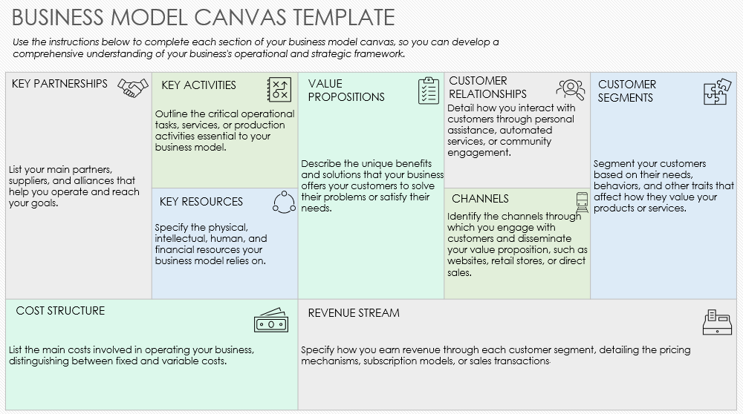
SIMPLE BUSINESS MODEL CANVAS TEMPLATE

Slide 2
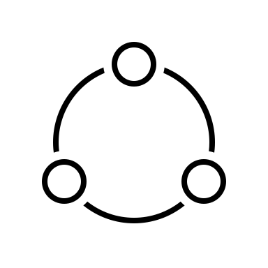
BUSINESS MODEL CANVAS TEMPLATE
Use the instructions below to complete each section of your business model canvas, so you can develop a comprehensive understanding of your business's operational and strategic framework.
CUSTOMER RELATIONSHIPS
List your main partners, suppliers, and alliances that help you operate and reach your goals. | Outline the critical operational tasks, services, or production activities essential to your business model. | Describe the unique benefits and solutions that your business offers your customers to solve their problems or satisfy their needs. | Detail how you interact with customers through personal assistance, automated services, or community engagement. | Segment your customers based on their needs, behaviors, and other traits that affect how they value your products or services.
 | Specify the physical, intellectual, human, and financial resources your business model relies on. |  | Identify the channels through which you engage with customers and disseminate your value proposition, such as websites, retail stores, or direct sales.
List the main costs involved in operating your business, distinguishing between fixed and variable costs. |  | Specify how you earn revenue through each customer segment, detailing the pricing mechanisms, subscription models, or sales transactions.
KEY PARTNERSHIPS
KEY ACTIVITIES
VALUE PROPOSITIONS
CUSTOMER SEGMENTS
KEY RESOURCES
CHANNELS
COST STRUCTURE
REVENUE STREAM

Slide 3
DISCLAIMER Any articles, templates, or information provided by Smartsheet on the website are for reference only. While we strive to keep the information up to date and correct, we make no representations or warranties of any kind, express or implied, about the completeness, accuracy, reliability, suitability, or availability with respect to the website or the information, articles, templates, or related graphics contained on the website. Any reliance you place on such information is therefore strictly at your own risk.

