Slide 1


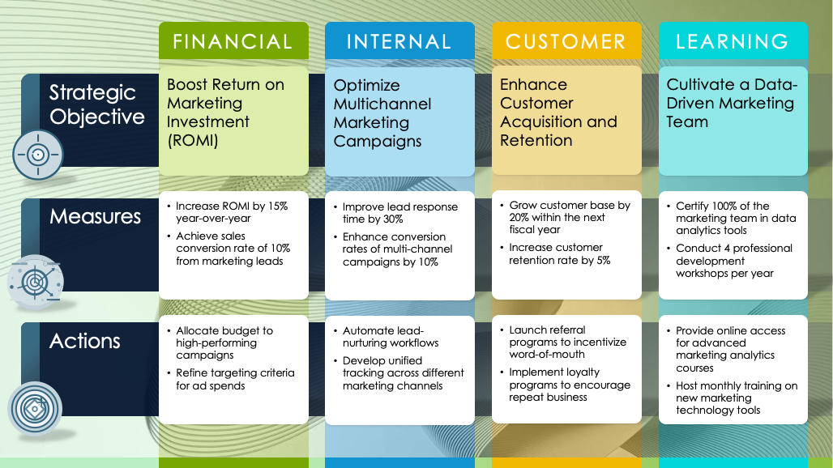
PowerPoint Marketing Balanced Scorecard Template
When to Use This Template: Marketing teams can use this balanced scorecard with or without example data to align their marketing strategy with the company's broader goals. Use this template for marketing strategy meetings, performance reviews, and training sessions to ensure all marketing efforts are driving toward strategic objectives.
Notable Template Features: Each section of this template is color-coded and includes space for a primary objective, a list of activities to achieve that objective, and specific metrics to measure success. The blank version of this template can be used in any department or business setting, while the example version contains sample objectives, measures, and initiatives specifically for marketing. The layout of this tool encourages analysis of how different activities impact the company's financial goals, customer engagement, operational efficiency, and employee development.

Slide 2
FINANCIAL
INTERNAL
CUSTOMER
LEARNING
text
text
text
text
Strategic Objective
text
text
text
text
Measures
text
text
text
text
Actions

Slide 3
example
FINANCIAL
INTERNAL
CUSTOMER
LEARNING
Boost Return on Marketing Investment (ROMI)
Optimize Multichannel Marketing Campaigns
Enhance Customer Acquisition and Retention
Cultivate a Data-Driven Marketing Team
Strategic Objective
Increase ROMI by 15% year-over-year
Achieve sales conversion rate of 10% from marketing leads
Improve lead response time by 30%
Enhance conversion rates of multi-channel campaigns by 10%
Grow customer base by 20% within the next fiscal year
Increase customer retention rate by 5%
Certify 100% of the marketing team in data analytics tools
Conduct 4 professional development workshops per year
Measures
Allocate budget to high-performing campaigns
Refine targeting criteria for ad spends
Automate lead-nurturing workflows
Develop unified tracking across different marketing channels
Launch referral programs to incentivize word-of-mouth
Implement loyalty programs to encourage repeat business
Provide online access for advanced marketing analytics courses
Host monthly training on new marketing technology tools
Actions

Slide 4
DISCLAIMER Any articles, templates, or information provided by Smartsheet on the website are for reference only. While we strive to keep the information up to date and correct, we make no representations or warranties of any kind, express or implied, about the completeness, accuracy, reliability, suitability, or availability with respect to the website or the information, articles, templates, or related graphics contained on the website. Any reliance you place on such information is therefore strictly at your own risk.

