Slide 1
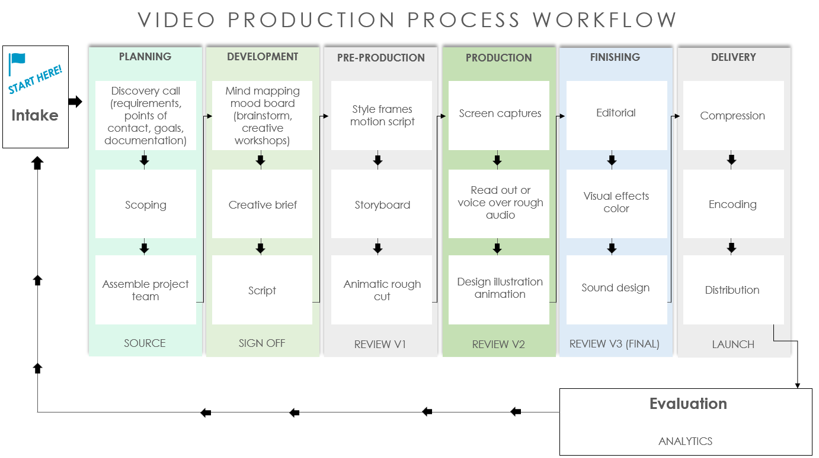
VIDEO PRODUCTION PROCESS WORKFLOW

Slide 2
VIDEO PRODUCTION PROCESS WORKFLOW
PLANNING
DEVELOPMENT
PRE-PRODUCTION
PRODUCTION
FINISHING
DELIVERY
START HERE!
Discovery call (requirements, points of contact, goals, documentation)
Mind mapping mood board (brainstorm, creative workshops)
Intake
Style frames motion script
Screen captures
Editorial
Compression
Read out or voice over rough audio
Visual effects color
Scoping
Creative brief
Storyboard
Encoding
Assemble project team
Script
Animatic rough cut
Design illustration animation
Sound design
Distribution
SOURCE
SIGN OFF
REVIEW V1
REVIEW V2
REVIEW V3 (FINAL)
LAUNCH
Evaluation
ANALYTICS

Slide 3
DISCLAIMER Any articles, templates, or information provided by Smartsheet on the website are for reference only. While we strive to keep the information up to date and correct, we make no representations or warranties of any kind, express or implied, about the completeness, accuracy, reliability, suitability, or availability with respect to the website or the information, articles, templates, or related graphics contained on the website. Any reliance you place on such information is therefore strictly at your own risk.

