Slide 1
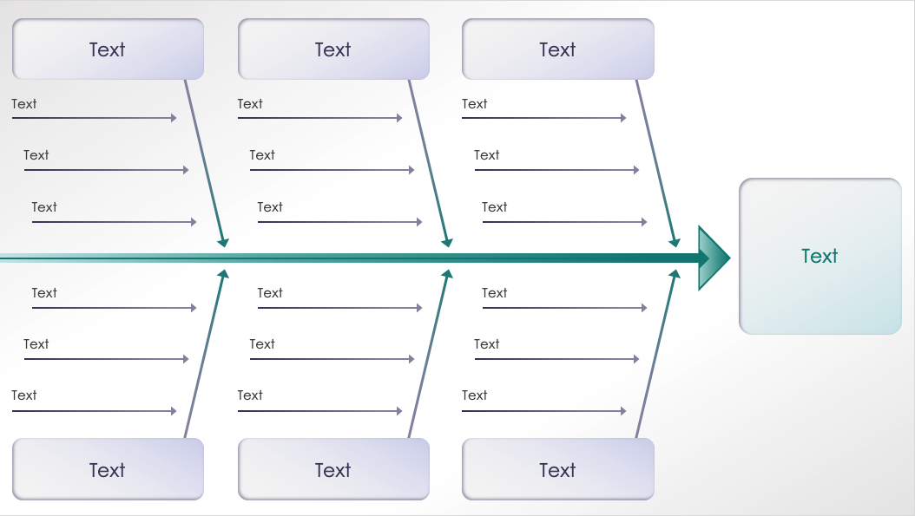
PowerPoint Traditional Ishikawa Diagram Template
When to Use This Template: This Ishikawa diagram is well suited for root cause analysis in quality management scenarios, such as in manufacturing or software development. The template is also an effective tool for educators in academic settings to teach problem-solving methodologies.
Notable Template Features: The template displays primary and secondary causes with branching lines, offering a multilevel perspective on the issue at hand. This allows teams to delve into further detail and systematically break down challenging problems. The diagram also draws attention to the central problem, promoting a clear and focused analysis during team discussions.

Slide 2
Text
Text
Text
Text
Text
Text
Text
Text
Text
Text
Text
Text
Text
Text
Text
Text
Text
Text
Text
Text
Text
Text
Text
Text
Text

Slide 3
DISCLAIMER Any articles, templates, or information provided by Smartsheet on the website are for reference only. While we strive to keep the information up to date and correct, we make no representations or warranties of any kind, express or implied, about the completeness, accuracy, reliability, suitability, or availability with respect to the website or the information, articles, templates, or related graphics contained on the website. Any reliance you place on such information is therefore strictly at your own risk.

