Slide 1


EXAMPLE MARKETING QUARTERLY BUSINESS REVIEW (QBR) TEMPLATE
When to Use This Template: Assess and present the performance of marketing campaigns over the past quarter with this marketing quarterly business review (QBR) template, available with or without sample data. Edit the slide deck to create a presentation that demonstrates how marketing strategies align with business outcomes, showcases achievements, and addresses areas for improvement in a structured, engaging format.
Notable Template Features: This template includes multiple slides designed for a comprehensive review, including objectives and results, lessons learned, and quarterly planning. Customizable sections allow for tailored messaging, while a user-friendly design saves time. You can highlight team successes and insights and communicate with stakeholders to strategize future marketing efforts.
Find more information on leading an effective QBR meeting in this compilation of free QBR and business review templates.

Slide 2
Your Company Name
00/00/0000

Slide 3
Marketing QBR Contents
Summary Review
Objectives and Key Results
Deliverables
Takeaways
Updates
Looking Ahead
Next Steps
Roadmap
Action Plan
Timeline
Summary and Discussion

Slide 4

Summary Review
TIME FRAME
01/01/20XX – 03/31/20XX
Looking back to last quarter…
ISSUES ADDRESSED
OUTCOMES
Improved website UX
Increased lead generation by 30%
Reduced customer acquisition costs
Higher website engagement
40% increase in newsletter sign-ups
15% decrease in bounce rate
Summary Notes:

Slide 5

Objectives and Key Results
Increase social media followers by 20%.
Improve email campaign open rates by 10%.
Launch new product line with 25% sales contribution.
+22%
+12%
+28%
Gained 22% more followers on social media.
Increased email campaign open rates by 12%.
Exceeded goal: new product line 28% of total sales.
Summary Notes:

Slide 6

Deliverables: KPIs
Social Media Engagement
METRIC
Email Open Rate
METRIC
New Product Sales
Increase by
METRIC
20%
TARGET
Improve to
25%
TARGET
Achieve
28%
TARGET
of total sales
Outline the key performance indicators (KPIs) that you will use to measure success. Include metrics like click-through rates, conversions, and ROI.

Slide 7
Deliverables: Goals and Outcomes
Goals
Outcomes
Publish 12 high-quality blog posts to drive website traffic.
Execute 4 targeted email marketing campaigns to nurture leads.
Launch new product with comprehensive marketing strategy to generate buzz and sales.
Achieved 22% increase in social media engagement, surpassing target.
Increased email open rate to 27%, indicating effective content strategy.
Exceeded expectations, with new product launch contributing 28% of total sales.
With QBR, you can clearly define your purpose and achieve measurable outcomes.

Slide 8
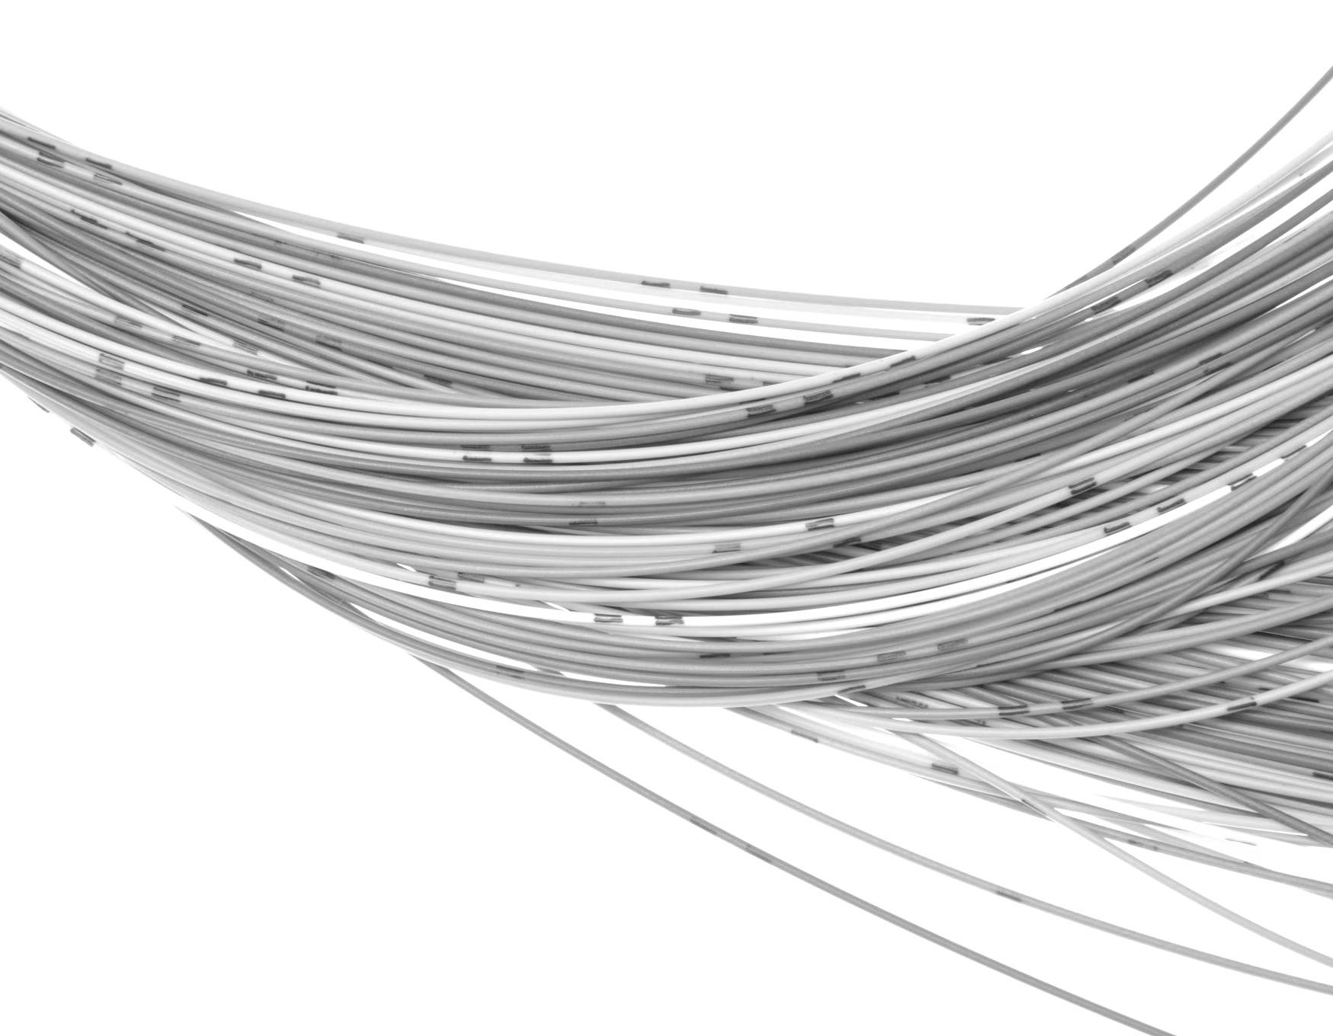
Takeaways
Highlights
What We Learned
Exceeded social media engagement and email open rate targets.
Surpassed sales expectations with launch of new product line.
Received recognition for industry innovation through marketing award.
Early and targeted pre-launch activities amplify product success.
Continuous A/B testing is vital for optimizing email campaign performance.
Influencer partnerships can significantly enhance brand visibility and credibility.

Slide 9


Updates
In Progress
Developing advanced analytics dashboard to track real-time marketing performance.
Finalizing integration of new CRM system to enhance lead management and personalization.
Preparing next influencer collaboration project, focusing on expanding reach in key markets.
Updates and News
Secured partnership with two major industry influencers, expanding our audience reach.
Awarded “Most Innovative Digital Campaign” at annual marketing industry awards.
Launched pilot for new CRM system, showing promising initial results in lead engagement.

Slide 10

Looking Ahead
Expand into two new market segments.
Increase investment in video marketing by 30%.
Develop loyalty program to increase customer retention.

Slide 11

Next Steps
What We’ll Keep Doing
What We’ll Stop Doing
What We’ll Start Doing
Continue leveraging social media and influencer partnerships to expand reach.
Maintain focus on high-quality content for blogs and email campaigns.
Persist in using data-driven strategies to guide marketing decisions.
Cease underperforming ad campaigns that yield low ROI.
Discontinue use of generic email content, focusing instead on personalization.
Stop neglecting video content in our marketing mix.
Invest in video marketing to engage our audience more effectively.
Implement loyalty program to boost customer retention rates.
Start using advanced AI tools for predictive analytics in campaign planning.

Slide 12

Roadmap
NEXT QUARTER GOALS
Achieve 30% increase in customer engagement through new video marketing initiatives.
Launch customer loyalty program to improve retention by 15%.
Expand market presence in two additional countries.
NEXT QUARTER TIME FRAME:
April 1 – June 30, 20XX

Slide 13

Roadmap
KEY METRICS
Customer Engagement Rate
Loyalty Program Enrollment Numbers
Market Expansion Success Rate
NEXT QUARTER TIME FRAME:
April 1 – June 30, 20XX

Slide 14


STRATEGIC ROADMAP
Time Frame | Strategy
April – May | Launch and promote video marketing campaigns across all platforms.
June | Introduce customer loyalty program, focusing on high-value customers first.
July – August | Perform market analysis and groundwork for expansion into new countries.
September | Evaluate video marketing campaign performance and adjust strategy accordingly.
October – November | Roll out loyalty program to all customer segments.
December | Finalize market entry strategies and begin international expansion.

Slide 15


Action Plan
Finalize partnerships for market expansion.
Hire video content creation team.
Develop infrastructure for loyalty program.

Slide 16
Timeline
Perform market analysis and expansion planning.
Launch and monitor video marketing efforts.
Finalize and launch loyalty program.
APRIL – JUNE
SEPTEMBER
OCTOBER – DECEMBER

Slide 17
Summary and Discussion
Summary of Quarterly Business Review
Closing Statements
Discussion

Slide 18
DISCLAIMER Any articles, templates, or information provided by Smartsheet on the website are for reference only. While we strive to keep the information up to date and correct, we make no representations or warranties of any kind, express or implied, about the completeness, accuracy, reliability, suitability, or availability with respect to the website or the information, articles, templates, or related graphics contained on the website. Any reliance you place on such information is therefore strictly at your own risk.

