Slide 1
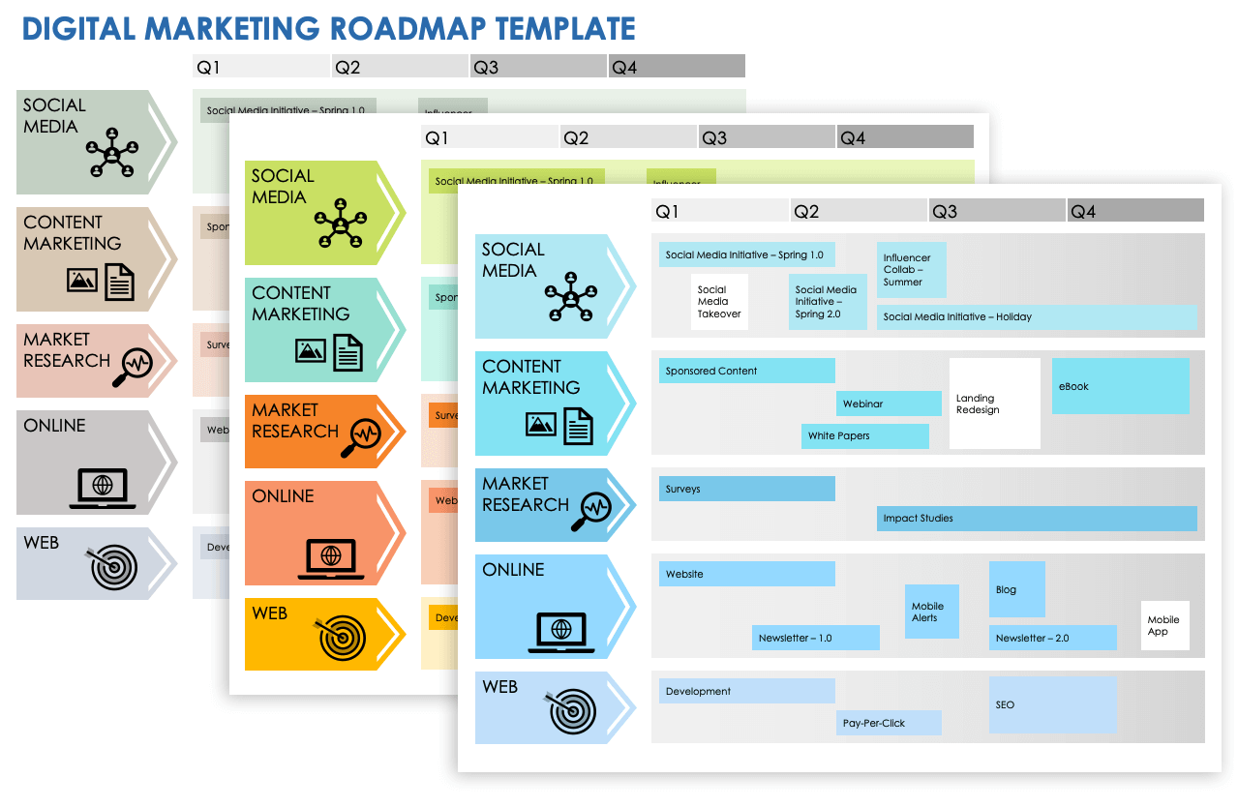
DIGITAL MARKETING ROADMAP TEMPLATE

Slide 2
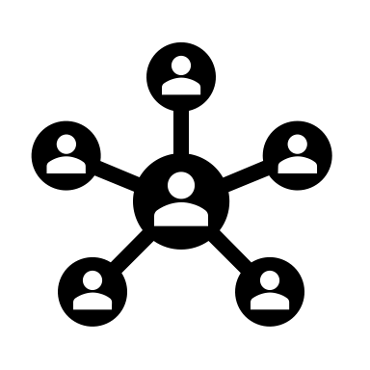
Q1 | Q2 | Q3 | Q4
SOCIAL MEDIA
Social Media Initiative – Spring 1.0
Influencer Collab – Summer
Social Media Takeover
Social Media Initiative – Spring 2.0
Social Media Initiative – Holiday
CONTENT
MARKETING
Sponsored Content
Landing Redesign
eBook
Webinar
White Papers
MARKET RESEARCH
Surveys
Impact Studies
ONLINE
Website
Blog
Mobile Alerts
Mobile
App
Newsletter – 1.0
Newsletter – 2.0
WEB
Development
SEO
Pay-Per-Click

Slide 3
Q1 | Q2 | Q3 | Q4
SOCIAL MEDIA
Social Media Initiative – Spring 1.0
Influencer Collab – Summer
Social Media Takeover
Social Media Initiative – Spring 2.0
Social Media Initiative – Holiday
CONTENT
MARKETING
Sponsored Content
Landing Redesign
eBook
Webinar
White Papers
MARKET RESEARCH
Surveys
Impact Studies
ONLINE
Website
Blog
Mobile Alerts
Mobile
App
Newsletter – 1.0
Newsletter – 2.0
WEB
Development
SEO
Pay-Per-Click

Slide 4
Q1 | Q2 | Q3 | Q4
SOCIAL MEDIA
Social Media Initiative – Spring 1.0
Influencer Collab – Summer
Social Media Takeover
Social Media Initiative – Spring 2.0
Social Media Initiative – Holiday
CONTENT
MARKETING
Sponsored Content
Landing Redesign
eBook
Webinar
White Papers
MARKET RESEARCH
Surveys
Impact Studies
ONLINE
Website
Blog
Mobile Alerts
Mobile
App
Newsletter – 1.0
Newsletter – 2.0
WEB
Development
SEO
Pay-Per-Click

Slide 5
DISCLAIMER Any articles, templates, or information provided by Smartsheet on the website are for reference only. While we strive to keep the information up to date and correct, we make no representations or warranties of any kind, express or implied, about the completeness, accuracy, reliability, suitability, or availability with respect to the website or the information, articles, templates, or related graphics contained on the website. Any reliance you place on such information is therefore strictly at your own risk.

